Slide 1

Sentiment Analysis of Goodreads Reviews
Determining the predictive power of user reviews

Slide 2
Background
Goodreads.com
Established 2007
65 million members
2 billion books
68 million reviews
https://www.goodreads.com/about/us
How accurately can text sentiment analysis of user reviews predict final user score?
Why? What is the business value of predicting the score?

Slide 3
Overview of Process
Data Collection & Preparation
Exploratory Data Analysis
Model Selection
Conclusion

Slide 4
Data Collection
Book data retrieved from Goodreads website
API allows for limited access to data from site
Web Scraping necessary to obtain book data & review text
BeautifulSoup module for web scraping

Slide 5
Data Collection
Book Data Points
Data | Description
ID | The Goodreads book ID
Title | Book title
Original title | The Book’s original title (e.g. native language title)
Author | Name of book author (first author if multiple)
Published | Publication date
Language | Language of book edition
Avg. Rating | The average user rating based on ratings of 1-5
Rating Count | The number of user ratings
Review Count | The number of user reviews
Genre 1 | The #1 book genre based on user votes
Genre 2 | The #2 book genre based on user votes
Genre 3 | The #3 book genre based on user votes
To read | The count of users who have this book on their “to read” shelf.
Currently reading | The count of users who have this book on their “currently reading shelf.
Favorites | The count of users who have this book on their “favorites” shelves.
Books in Goodreads DB scanned randomly
Table lists data points collected for each book scanned
Features like Genre and Shelves not used in final analysis

Slide 6
Data Collection
Criteria For Inclusion in Analysis
Book available in English
Book has at least 40 reviews written
No duplicates (e.g. books with multiple titles or editions are only included once)
Of 95,000 titles scanned, 7,615 (12.5%) met criteria

Slide 7
Data Collection
Review Data Points
Data point | Description
Review ID | The Goodreads review ID
Book ID | The Book ID associated with this review
Review Date | The date the review was submitted
Rating | The score from 1-5 that the reviewer gave the book. Not all reviews include a rating.
Review Text | The raw review text
Reviews scraped for each of the 7,615 titles which matched selection criteria
Between 40 and 300 reviews scraped for each title.
40 was minimum for inclusion
300 was maximum that could be scraped
Total of 1,366,205 reviews scraped

Slide 8
Data Preparation
Review text processing:
Remove punctuation (except ‘ and -)
Identify individual words as separated by spaces
Reviews with fewer than 30 words excluded

Slide 9
Review Scoring
Four distinct sentiment lexicons used
Each review word matched with sentiment lexicons and given a score when matched
Aggregates of word scores for each review used as features in analysis
Lexicon | Words | Description
AFINN | 2,477 | Sentiment scores ranging from -5 to +5
Bing Liu | 6,787 | Polarity scores. 0 for negative, 1 for positive
Harvard Inquirer | 3,629 | Polarity scores. 0 for negative, 1 for positive
MPQA | 6,901 | Polarity scores. 0 for negative, 1 for positive

Slide 10
Feature Selection
Features
Review ID | Total MPQA count
Rating | Total Inquirer count
Word Count | Positive AFINN ratio
AFINN Mean | Positive Bing ratio
Bing Mean | Positive MPQA ratio
MPQA Mean | Positive Inquirer ratio
Inquirer Mean | Negative AFINN ratio
AFINN Median | Negative Bing ratio
Bing Median | Negative MPQA ratio
MPQA Median | Negative Inquirer ratio
Inquirer Median | Positive AFINN density
AFINN Sum | Positive Bing density
Bing Sum | Positive MPQA density
MPQA Sum | Positive Inquirer density
Inquirer Sum | Negative AFINN density
Positive AFINN Count | Negative Bing density
Positive Bing Count | Negative MPQA density
Positive MPQA Count | Negative Inquirer density
Positive Inquirer Count | AFINN Words Ratio
Negative AFINN Count | Bing Words Ratio
Negative Bing Count | MPQA Words Ratio
Negative MPQA Count | Inquirer Words Ratio
Negative Inquirer Count | Caps Word Count
Total AFINN count | Exclamation Count
Total Bing count | All Caps Density
Aggregates of sentiment lexicon scores
Calculated columns based on aggregates
Additional features (all caps words, count of exclamation points)
Mention something about feature choices
Note about feature importance
50 features total
Reviews with outlier values (> 3 SD) for count of positive/negative dropped
Reviews without a rating dropped

Slide 11
Feature Selection
Top Features – As scored by Random Forest Classifier

Slide 12
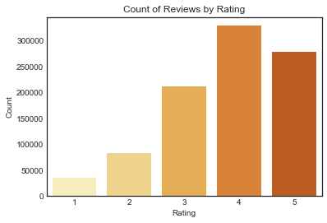
Exploratory Data Analysis – Rating Distribution

Slide 13
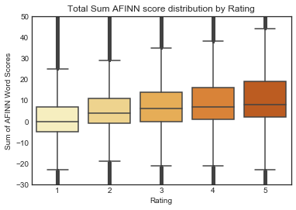
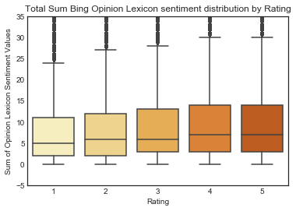
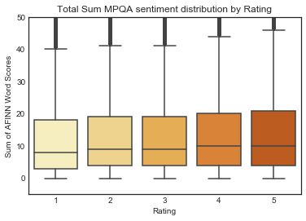
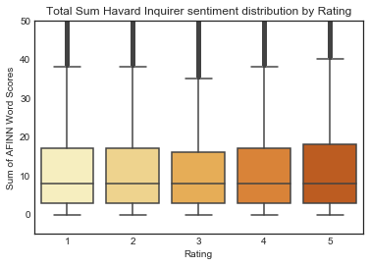
Exploratory Data Analysis – Score Sum Distributions

Slide 14
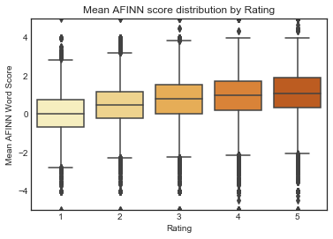
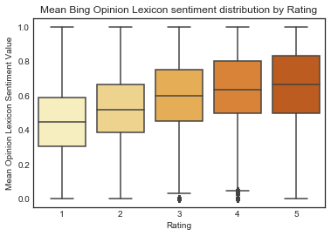
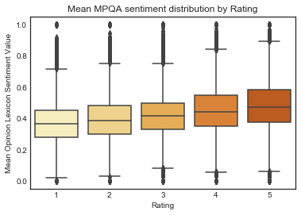
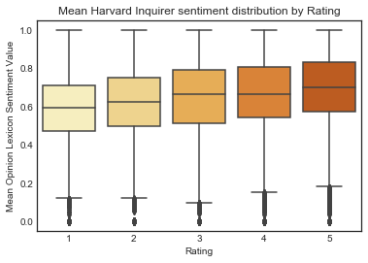
Exploratory Data Analysis – Score Mean Distributions

Slide 15
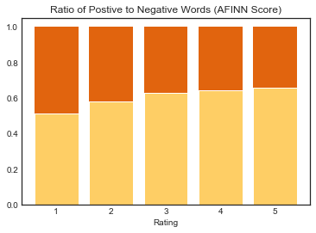
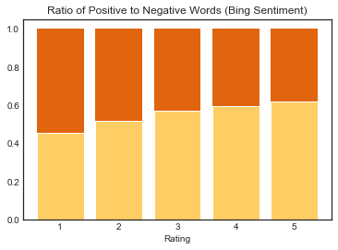
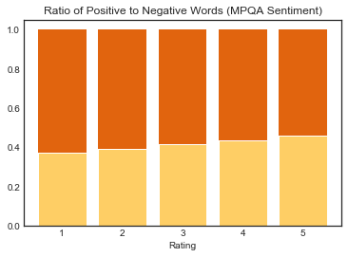
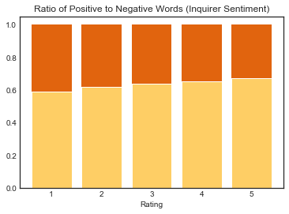
Exploratory Data Analysis – Positive / Negative Ratio

Slide 16
Exploratory Data Analysis - Summary
Review scores unevenly distributed
Heavily skewed toward higher scores
Might indicate readers who didn’t enjoy book less likely to leave review. Selection Bias
Examining the distribution of features reveals that there is an upward trend in metrics (e.g. sum of scores, mean of scores, etc.).
Higher rated reviews tend to have higher sum, mean, medians, and other aggregates of the word scores
This pattern is observed across each lexicon
While trend is clear, the data is very spread out in each category, indicative of a wide degree of variance.
Other metrics such as ratio of positive scored to negative scored words in review also tend to increase as review score increases
This pattern is also observed across all four lexicons
Conclusion – Clear visible trend between rating value and overall sentiment score, but wide variance may mean the association is weak.

Slide 17
Classification Model
Five Category Classification – Summary of Results
Classifier | Score | Avg. Precision | Avg. Recall
K-Nearest Neighbors | 0.27 | 0.30 | 0.29
Decision Trees | 0.27 | 0.26 | 0.37
Naïve Bayes | 0.28 | 0.36 | 0.28
MLP | 0.37 | 0.37 | 0.38
Random Forest | 0.38 | 0.38 | 0.38
Random Grid cross-validation used to optimize hyperparameters
MLP and Random Forest classifiers resulted in best accuracy.
Use of scalars to standardize features did not produce meaningful improvements in the results.

Slide 18
Classification Model
Two Category Classification – Summary of Results
Rating | Score | Precision – 0 | Recall – 0 | Precision – 1 | Recall – 1
5 | 0.69 | 0.72 | 0.91 | 0.45 | 0.17
4 | 0.64 | 0.65 | 1.00 | 0.50 | 0.00
3 | 0.77 | 0.77 | 1.00 | 0.00 | 0.00
2 | 0.91 | 0.91 | 1.00 | 0.00 | 0.00
1 | 0.96 | 0.96 | 1.00 | 0.00 | 0.00
Converted classification into five separate two-category classification problems to see if model could predict individual ratings.
Used MLP classification model
Scores and precision are high, but only because model guessed 0 for nearly all results.
Notice Recall for scores 2-5 are zero, indicating that the model did not predict that review was in given score category a single time.

Slide 19
Classification Model
Two Category Classification – Summary of Results
Classifier | Score | Precision – Neg. | Recall – Neg. | Precision – Pos. | Recall – Pos.
MLP | 0.66 | 0.55 | 0.22 | 0.68 | 0.90
Random Forest | 0.62 | 0.66 | 0.78 | 0.53 | 0.37
Reformatted classification into two categories –
Positive (Rating >= 4)
Negative (Rating <= 3)
Used MLP and Random Forest which had best accuracy in 5-category classification
Reducing classification to two categories significantly improved model accuracy, though still low

Slide 20
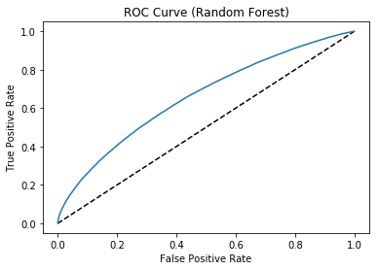
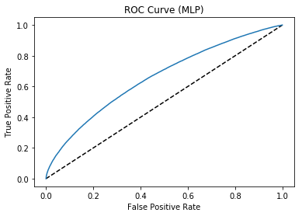
Classification Model
Two Category Classification – ROC Curves
ROC Curves visualize model accuracy
Curve close to 45 degree line indicate low accuracy

Slide 21
Conclusion
Sentiment Analysis can be used to provide a view into the attitude of the reader, but falls short of being able to accurately predict the final score.
Trends exist showing a relationship between higher rating and higher sentiment score values, however this association is not strong enough to produce an accurate model.
MLP and Random Forest classifiers produced the most accurate predictions
Additions that may potentially improve model accuracy
Additional lexicons
Analysis of text beyond positive or negative word sentiment, e.g. emotional connotations associated with words
Inclusion of additional review features not related to sentiment

